Slide 1

Healthcare Analytics Project
Predicting Heart Disease

Slide 2
Objective
The objective of this project is to find key metrics and factors and show the meaningful relationships between attributes contributing to cardiovascular disease.
Analyzing the given health and medical data and develop a predictive model for better future preparation.

Slide 3
Benefits
Early detection and prevention
Improved patient care and personalized medicine
Enhanced diagnostic accuracy
Cost savings and resource optimization
Data-driven decision-making

Slide 4
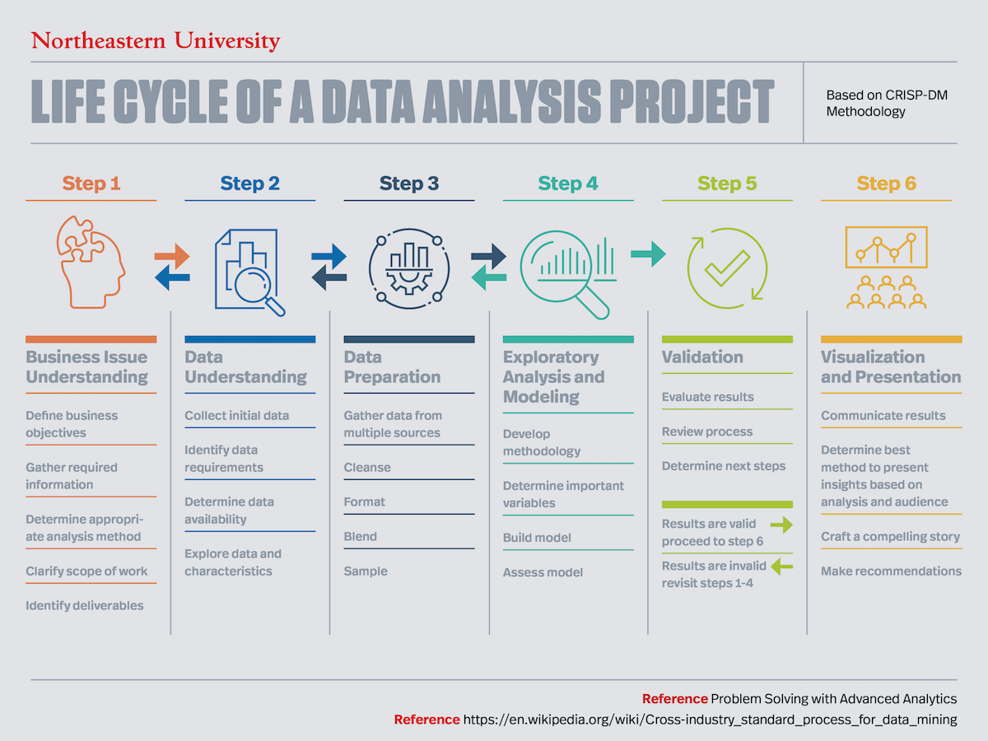
Architecture

Slide 5
Data Validation and Transformation
Name Validation - Validation of files name as per the DSA. We have created a
regex pattern for validation. After it checks for date format and time format if
these requirements are satisfied, we move such files to "Good_Data_Folder" else
"Bad_Data_Folder.“
Number of Columns – Validation of number of columns present in the files, and if
it doesn't match then the file is moved to "Bad_Data_Folder.“
Name of Columns - The name of the columns is validated and should be the same
as given in the schema file. If not, then the file is moved to "Bad_Data_Folder".
Data type of columns - The data type of columns is given in the schema file. It is
validated when we insert the files into Database. If the datatype is wrong, then the
file is moved to "Bad_Data_Folder".
Null values in columns - If any of the columns in a file have all the values as
NULL or missing, we discard such a file and move it to "Bad_Data_Folder".

Slide 6
Data Loading
We download the data from the link provided by the iNeuron team.
After downloading the data, we store the data in our system in a csv format to be accessed.
Later in R Studio, we load the data onto our workspace using the read.csv command. The null values are dropped and any the first row is taken as variable names.

Slide 7
Exploratory Data Analysis
The exploratory data analysis on the data is performed after the data has been loaded.
We check what different columns are available for us to work with and we draw various visualizations from the data to get a better sense of the data we are working with.
We make a correlation matrix and also draw correlation plots between all the variables of the data to figure out which variables are most significant in the development of the heart disease.

Slide 8
Data Preparation
After performing EDA, the data is prepared to be loaded into the classification
model.
We check what different columns are available for us to work with see if theres any missing data. We then delete the unimportant variables and delete data points that are not defined.
We deal with multicollinearity and prepare the data for model.

Slide 9
The Model
We use the Logistic Regression model as the data present is to be classified as binary coded as 0 and 1.
We split the data set into two – the training and the test set. The training set is used to train the logistic model and the test set is used to check the accuracy of the predictions.

